Slide 1


Vacuum Cleaner
Intelligent Agent

Slide 2

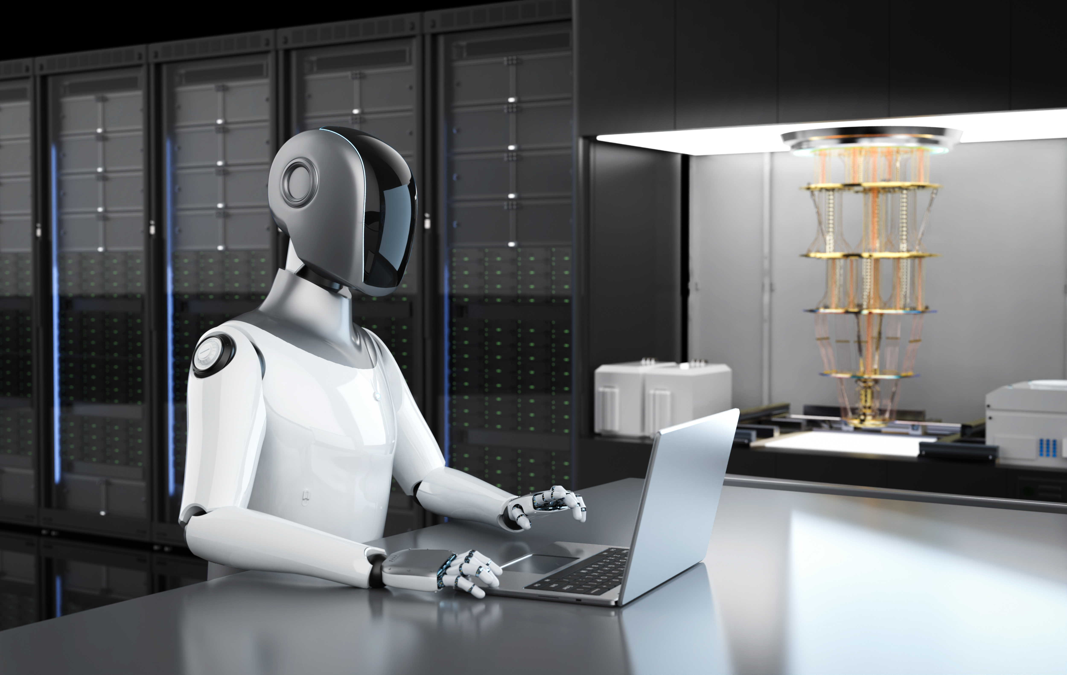
Project Overview
This project simulates an intelligent vacuum cleaner agent that operates in a grid-based environment.
The agent’s goal is to clean all dirty cells in the room while minimizing the number of movements, using different search algorithms studied in Artificial Intelligence.

Slide 3
Problem Statement
An intelligent vacuum cleaner needs to clean a room represented as a grid that contains clean and dirty cells.
The objective is to reach and clean all dirty cells using the minimum number of steps, while making intelligent decisions about movement.

Slide 4


Why is this Problem Important?
01
It is a practical application of Search Algorithms in Artificial Intelligence.
02
It represents an intelligent agent that perceives its environment and makes decisions.
03
It helps compare the behavior and efficiency of different search strategies.

Slide 5
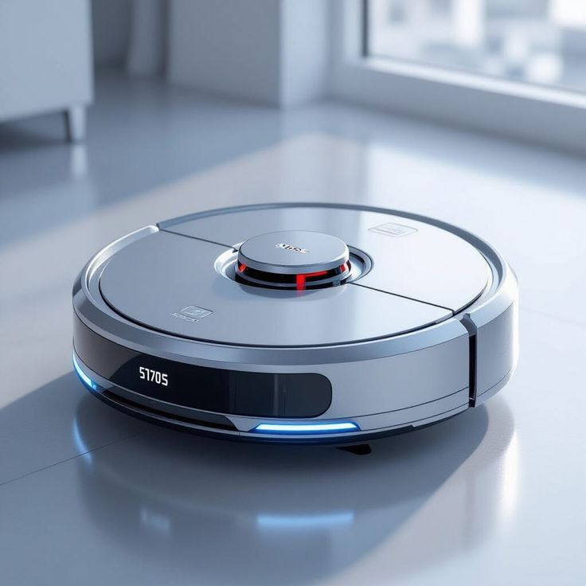


Algorithms Used
Breadth-First Search (BFS)
Depth-First Search (DFS)
Uniform Cost Search (UCS)
Iterative Deepening Search (IDS)
A* Search Algorithm

Slide 6
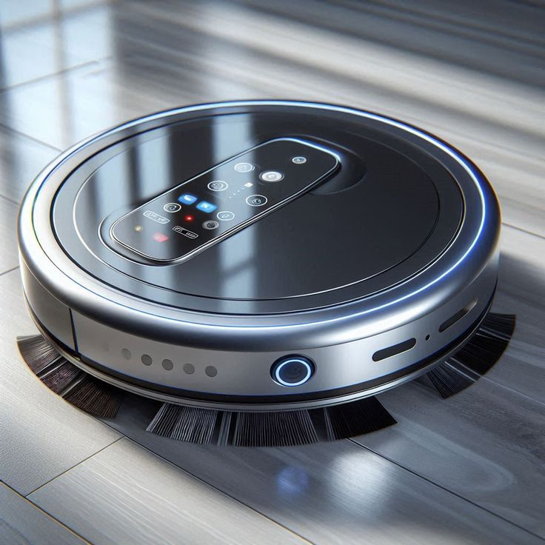

Project Workflow
How it works
Generate the environment as a 2D grid.
Identify all dirty cells in the room.
Select a target dirty cell.
Apply the selected algorithm to find a path.
Move the vacuum cleaner along the path.
Clean the dirty cell.
Repeat the process until all cells are clean.

Slide 7
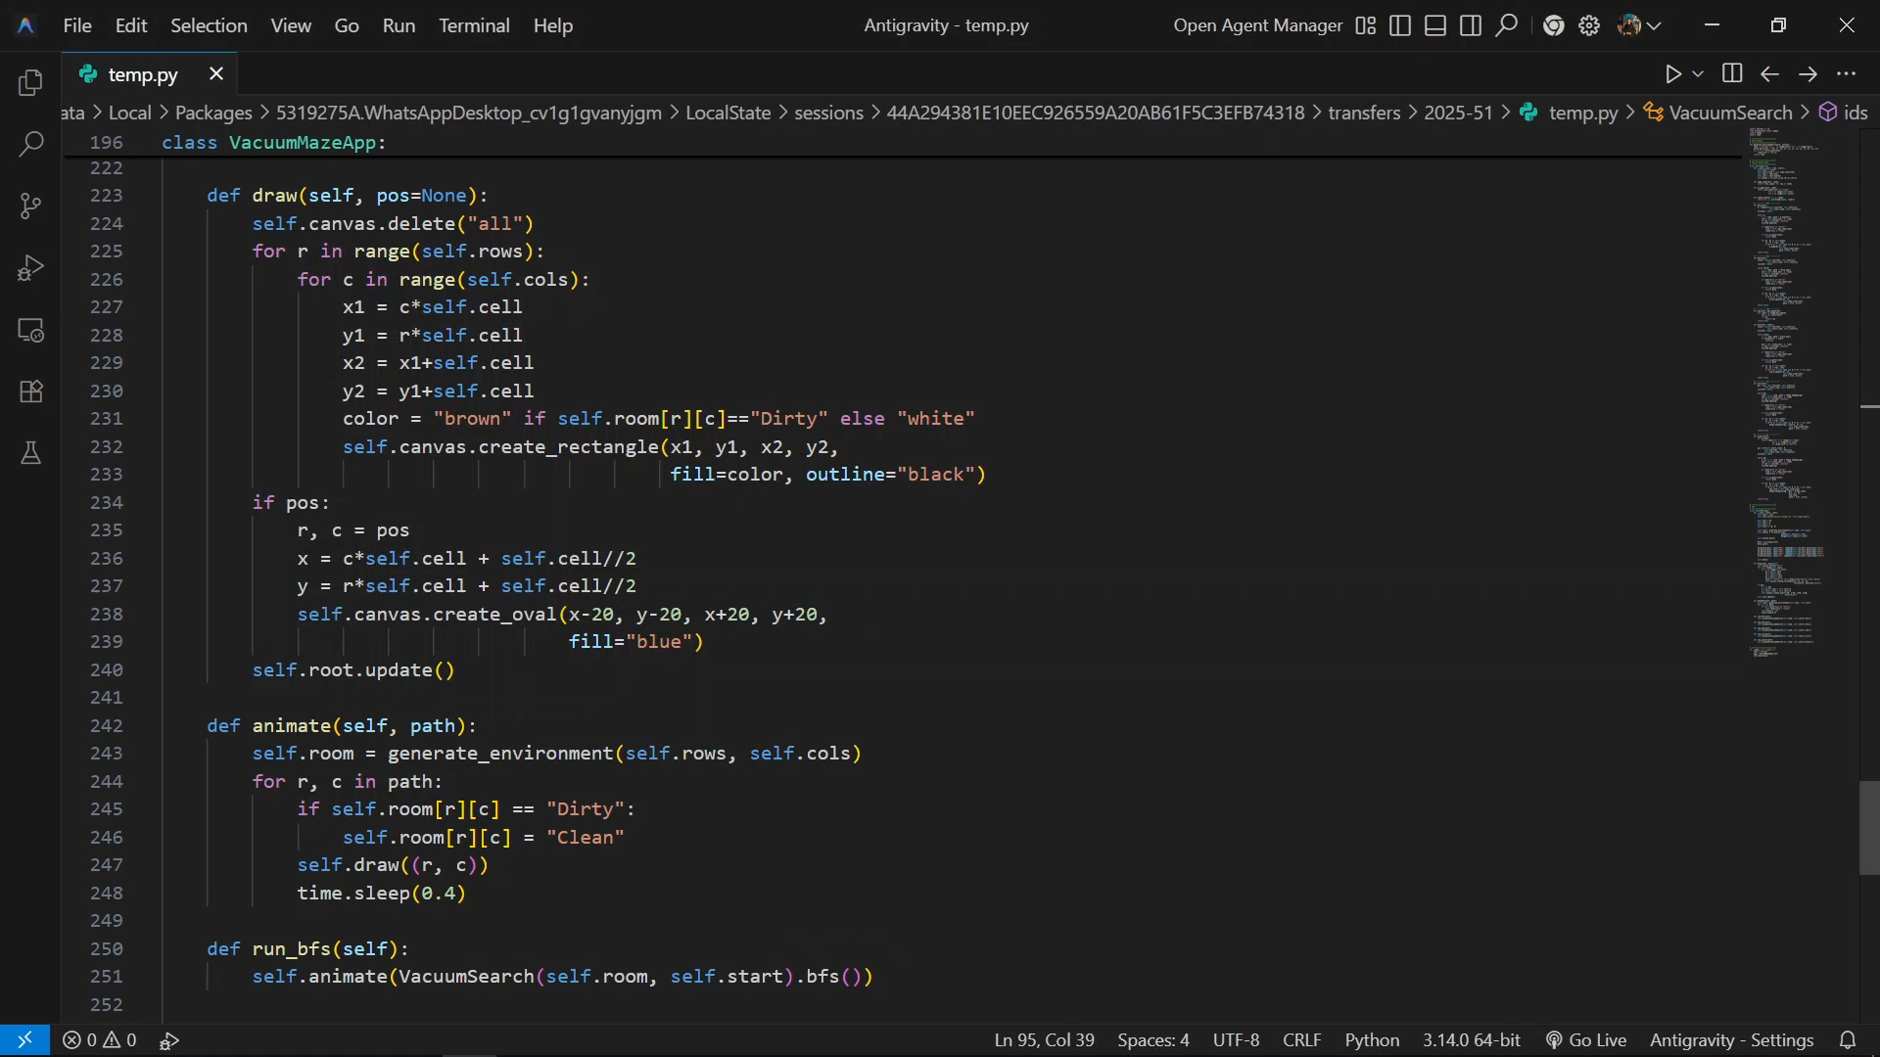

Slide 8
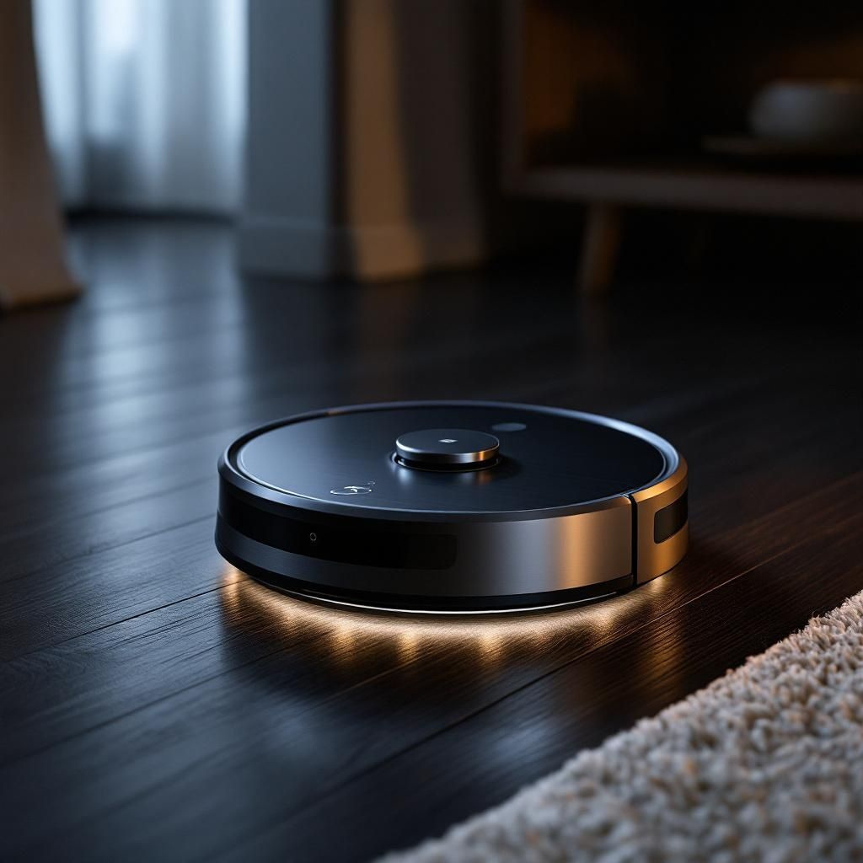
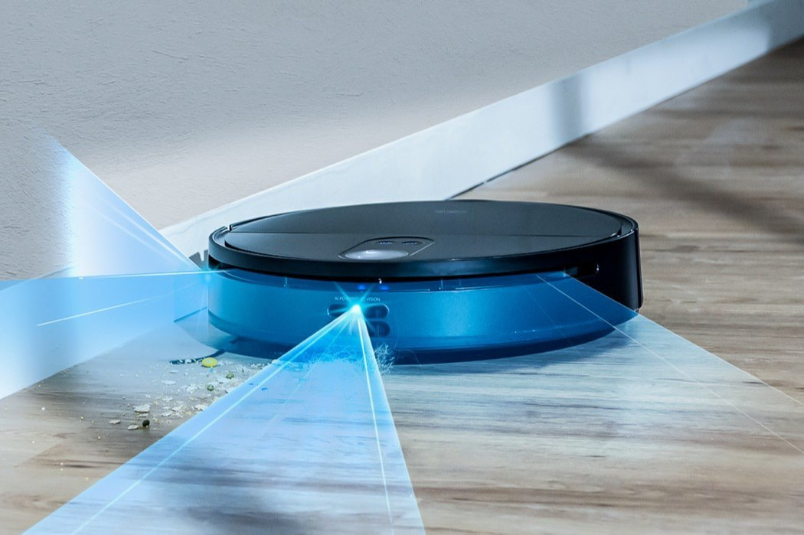
Output
The movement path of the vacuum cleaner.
Final state of room where all cells are clean.
Technologies Used
Programming Language: Python
Concepts: Artificial Intelligence, Search Algorithms, Intelligent Agents

Slide 9

Thank You
Prepared By
Abdelrahman Ahmed Elhabian
Abdelrahman Osama Mohamed
Abdelrahman Ismaeel Youssef
Amr Khaled Ahmed
Omar Hashem Rezk

